Slide 1
LENDING CLUB CASE STUDY SUBMISSION
Group Assignment
Ashutosh Kulkarni
Kamal Mehta
Peeyush Singhal
Sayan Banerjee

Slide 2
Introduction and Purpose
Introduction: Lending Club is the largest online loan marketplace, facilitating personal loans, business loans, and financing of medical procedures. Like most other lending companies, lending loans to ‘risky’ applicants is the largest source of financial loss (called credit loss). Lending club is interested to understand the ‘risky’ applicants via the historical data to minimize its financial loss.
Purpose: The company wants to understand the driving factors (or driver variables) behind loan default, i.e. the variables which are strong indicators of default. The company can utilise this knowledge for its portfolio and risk assessment. The purpose of this Exploratory Data Analysis (EDA) is to understand
consumer attributes and
loan attributes
influence the tendency of default.

Slide 3
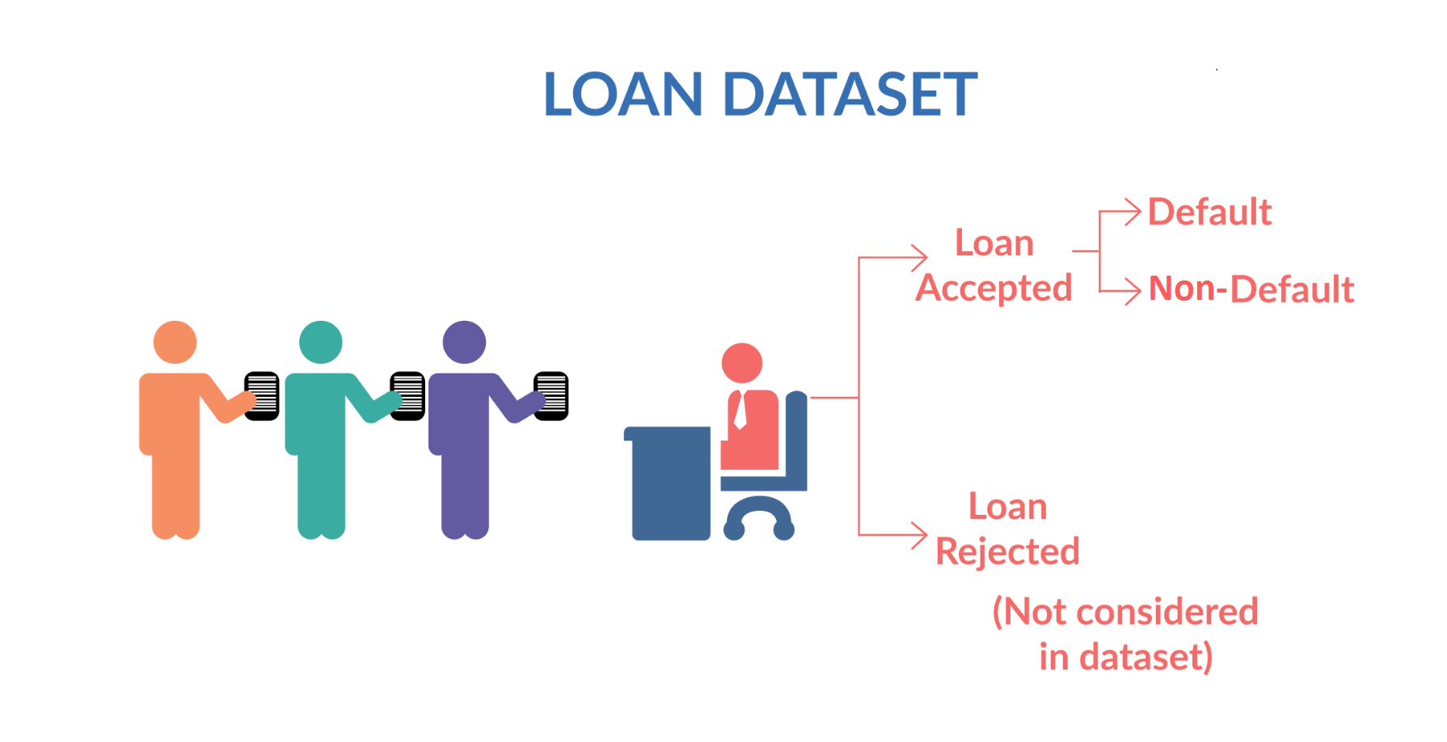
Data Understanding
Loan Variables
Pre-Loan Variables
Loan Variables (Company Intrinsic)
Post-Loan Variable
Included
Excluded
Excluded
These are customer profile variables which are available during loan application phase.
Some of these might indicate whether a customer is likely to default or not. These are the variables which we are going to identify and focus on during this EDA case study.
These are the variables which typically lender controls and can adjust based on the profile of loan applicant. These variables are loan amount (that is finally approved), interest rate, term and monthly repayment amount. It is clear from business understanding that these variables should not be considered as driver variables for default.
These are variables which are generated after the loan has been granted to loan applicant and when loan cycle has started.
These typically include payments, payments missed, payment due date etc. It is clear from business understanding that these variables should not be considered as driver variables for default as these cannot indicate the likelihood of default at loan application stage.
Loan Accepted – Non-Default (Fully Paid)
Included
Loan Accepted – Current**
Excluded
Loan Accepted – Default (Charged Off)
Included
**Loan Accepted – (loan_status=)Current, an intermediate state, is excluded from analysis because these customers do not participate to show propensity to default or non-default. The propensity can be understood only for completed loans

Slide 4
Data Cleaning and Manipulation
Sanity Check
Cleaning
Manipulation
Removing Rows
Finding percentage of missing values in each column
Imputation for missing values
Having 100% missing values or same values (zero standard deviation)
Loan status == Current **
Unique / Duplicate values in columns
Where every row has a different value
Cleaning
Leading & Lagging spaces
Converting String to Integer (example : months)
Remove signs (example % in interest rates)
Emp_length = NA
Revol_util = 0
mths_since_last_record = -1
pub_rec_bankruptcies = 0
Loan Variables and Post-Loan Variables **
Removing Columns
** see Data Understanding

Slide 5
Data Analysis - Methodology
< ------------- Plots ------------------------>
Custom Functions
Analysis
^||Tests||v
Analysis – Univariate, Segmented, Bivariate for quantitative and categorical variables
Individual Column Analysis
Univariate
Segmented Univariate
Plots and Tests were done for all the analysis types
Plots – Bubble Plots, count plot, violin plot, box-plot, histogram, heat-maps, mosaic plot
Bivariate Columns Analysis
Correlation : Quantitative & Categorical
Impact on loan status based on 2 variables
Tests – Independent t-test, chi-squared test
Derived Columns Analysis
Data driven (binning – quantitative variable, date)
Business driven
(ratios between 2 variables)

Slide 6
Data Analysis 1/n

Slide 7
Recommendation
Based on the goals of analysis we found the following variables to be important
Purpose
Pub_Rec
..
..
..
xx
xx
ccc
xx
x
cc

